Slide 1


Using Copilot Pro with Microsoft Outlook
Notes:
https://copilot.cloud.microsoft/en-US/copilot-outlook

Slide 2

“Email, instant messaging, and cell phones give us fabulous communication ability, but because we live and work in our own little worlds, that communication is totally disorganized.”
- Marilyn vos Savant

Slide 3

Drafting an email

Slide 4
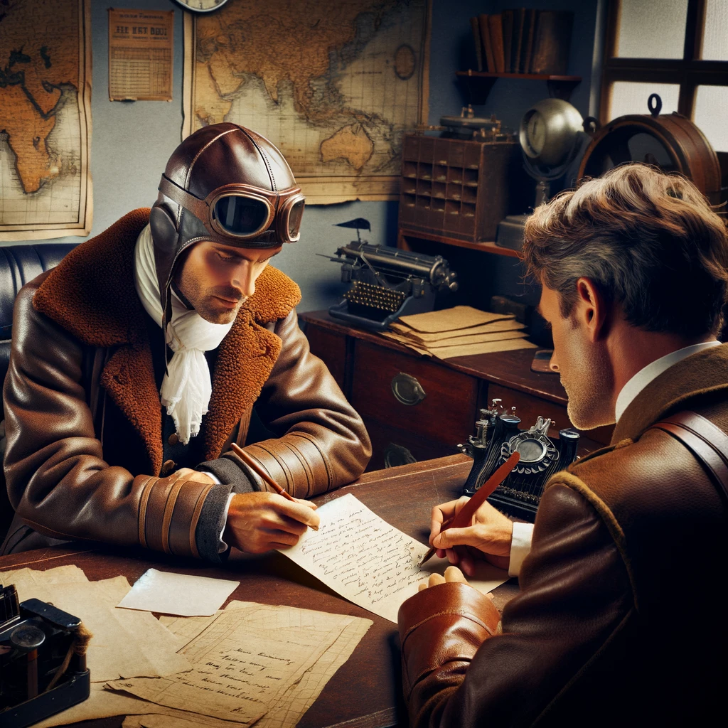
Email Coaching
Notes:
https://support.microsoft.com/en-us/office/email-coaching-with-copilot-in-outlook-91a3cd56-1586-4a31-85c7-2eb8cdb02405

Slide 5

Summarize an Email Thread
Notes:
https://support.microsoft.com/en-us/office/summarize-an-email-thread-with-copilot-in-outlook-a79873f2-396b-46dc-b852-7fe5947ab640

Slide 6

Replying to email

Slide 7


